Slide 1
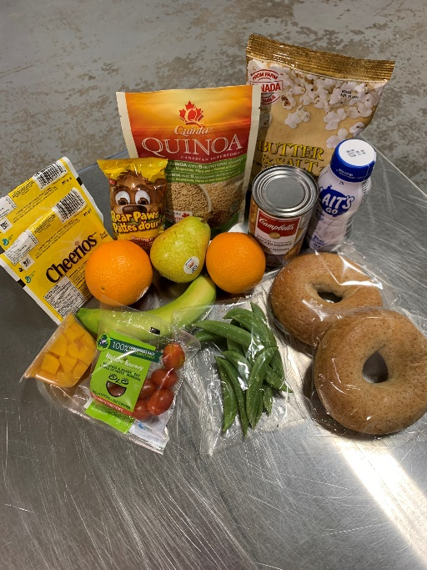
VOLUNTEER INTRODUCTION
A 10-year-old boy waited outside the locked doors of a school breakfast program. The program was to start at 8:15 and the child stood outside at 7:15 in the dark, in the cold and alone.
He explained he had not had any food on the weekend and was hungry. Could he please have some food? This child inspired the launch of the Food4Kids program, a not-for profit charity that began in 2012.
Now 11 years later, here in Halton, we currently pack and distribute bags of nutritious food to help feed close to 1,000 children from over 600 families every Friday.
Volunteering opportunities are available in Burlington/Oakville, Milton and Halton Hills.
#weekendswithouthunger #caringforothers #nochildgoeshungry

Slide 2
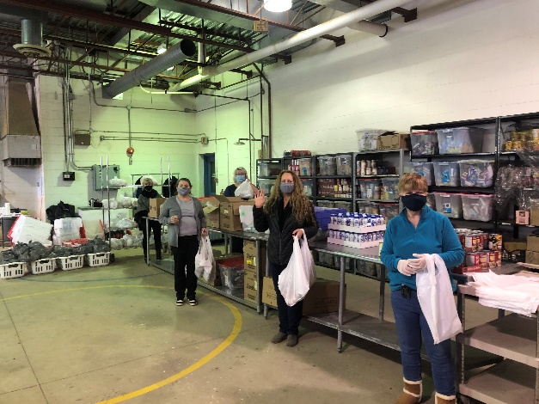
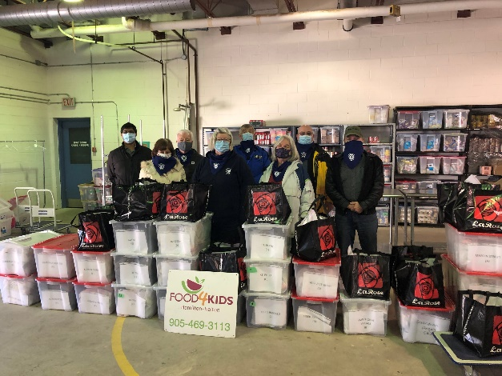
BECOMING A VOLUNTEER
Volunteers are our most valuable resource, and we would not exist without them! All individuals who are qualified and meet requirements for a position are welcomed and needed. And it’s as easy as Step 1, 2, 3…
Step 1 - Fill out the online Application Form. All individuals who are qualified and meet minimum eligibility requirements for a position are welcomed and needed. Please note the minimum age requirement is 16 years.
As some duties put volunteers in direct contact with children at homes or schools, kindly note that some roles require providing Food4Kids with a valid Vulnerable Sector Check before you will be able to begin. It can be obtained by applying HERE.
To keep in accordance, each year thereafter, you will be asked to sign an Offense Declaration form.
​
#weekendswithouthunger #caringforothers #nochildgoeshungry

Slide 3
BECOMING A VOLUNTEER
Step 2 – Choose a role (or two or more) that’s right for you!
Packing food bags
School deliveries
Home deliveries
Grocery shopping
Packing support (Help restock the food, move crates and bins. Must be able to lift 25 lbs.)
Food drive sorting/Inventory
Special events (ie. Battle of the Chefs, Bottle Drives, Food Drives)
Fundraising
General help
#weekendswithouthunger #caringforothers #nochildgoeshungry
Notes:
Milton
Food Packing
Thursdays from 11am – 12:30pm at Country Heritage Park – 8650 Tremaine Rd. Milton – 4 ppl required
School Deliveries
Pick up Friday mornings at 9am from Country Heritage Park – 8650 Tremaine Rd. Milton – Deliver to 4-5 schools – 1hr commitment – 6 routes to fill each week
Home Deliveries
Pick up Thursday afternoons at 12:30pm from Country Heritage Park – 8560 Tremaine Rd. Milton – Deliver to 4-5 homes – 1hr commitment – 6 routes to fill each week
Food Drive Sorting
Be on a call list to help sort and shelve items donated through Food Drives.
Milton
Shoppers
Be on a call list to receive grocery gift cards to purchase sale items at local grocery stores when needed.
​​
Summer Volunteer Positions
Package food weekly or delivery of food bins to participating families. (July – August only)
​
Food Drive Organizer
Run a food drive in your community or at work. Contact us for the most needed items, guidelines and promotional materials.
​
Committee Members
Assist with planning and running fundraising events.

Slide 4
BECOMING A VOLUNTEER
Step 3 –Your completed application form will be directed to the applicable program coordinator in your area:
​
Burlington/Oakville
jeannie@food4kidshalton.ca
​
Halton Hills
eva@food4kidshalton.ca
​
Milton
stacey@food4kidshalton.ca
Once received the Coordinator will contact you to arrange a meeting to finalize getting you started.
Thank you for supporting Food4Kids Halton!
#weekendswithouthunger #caringforothers #nochildgoeshungry

